Slide 1
Retail Store Project
By
Bhargava Ram Kulla

Slide 2
Infrastructure Setup
Create VPC
Enable DNS Support for VPC (important for EKS & RDS)
Create Two Public Subnets
Create 2 Private Subnets
Create Internet Gateway & Attach to VPC
Attach IGW
Allocate Elastic IP
Create NAT Gateway in Public Subnet 1
Create Route Tables
Associate with Public Subnets
Add Route to Internet
Public Route Table
Private Route Table
Add NAT Gateway route
Create EKS Cluster
Create a DB Subnet Group
Create RDS (MySQL) for catalog Service
Create DynamoDB Table for cart Service

Slide 3
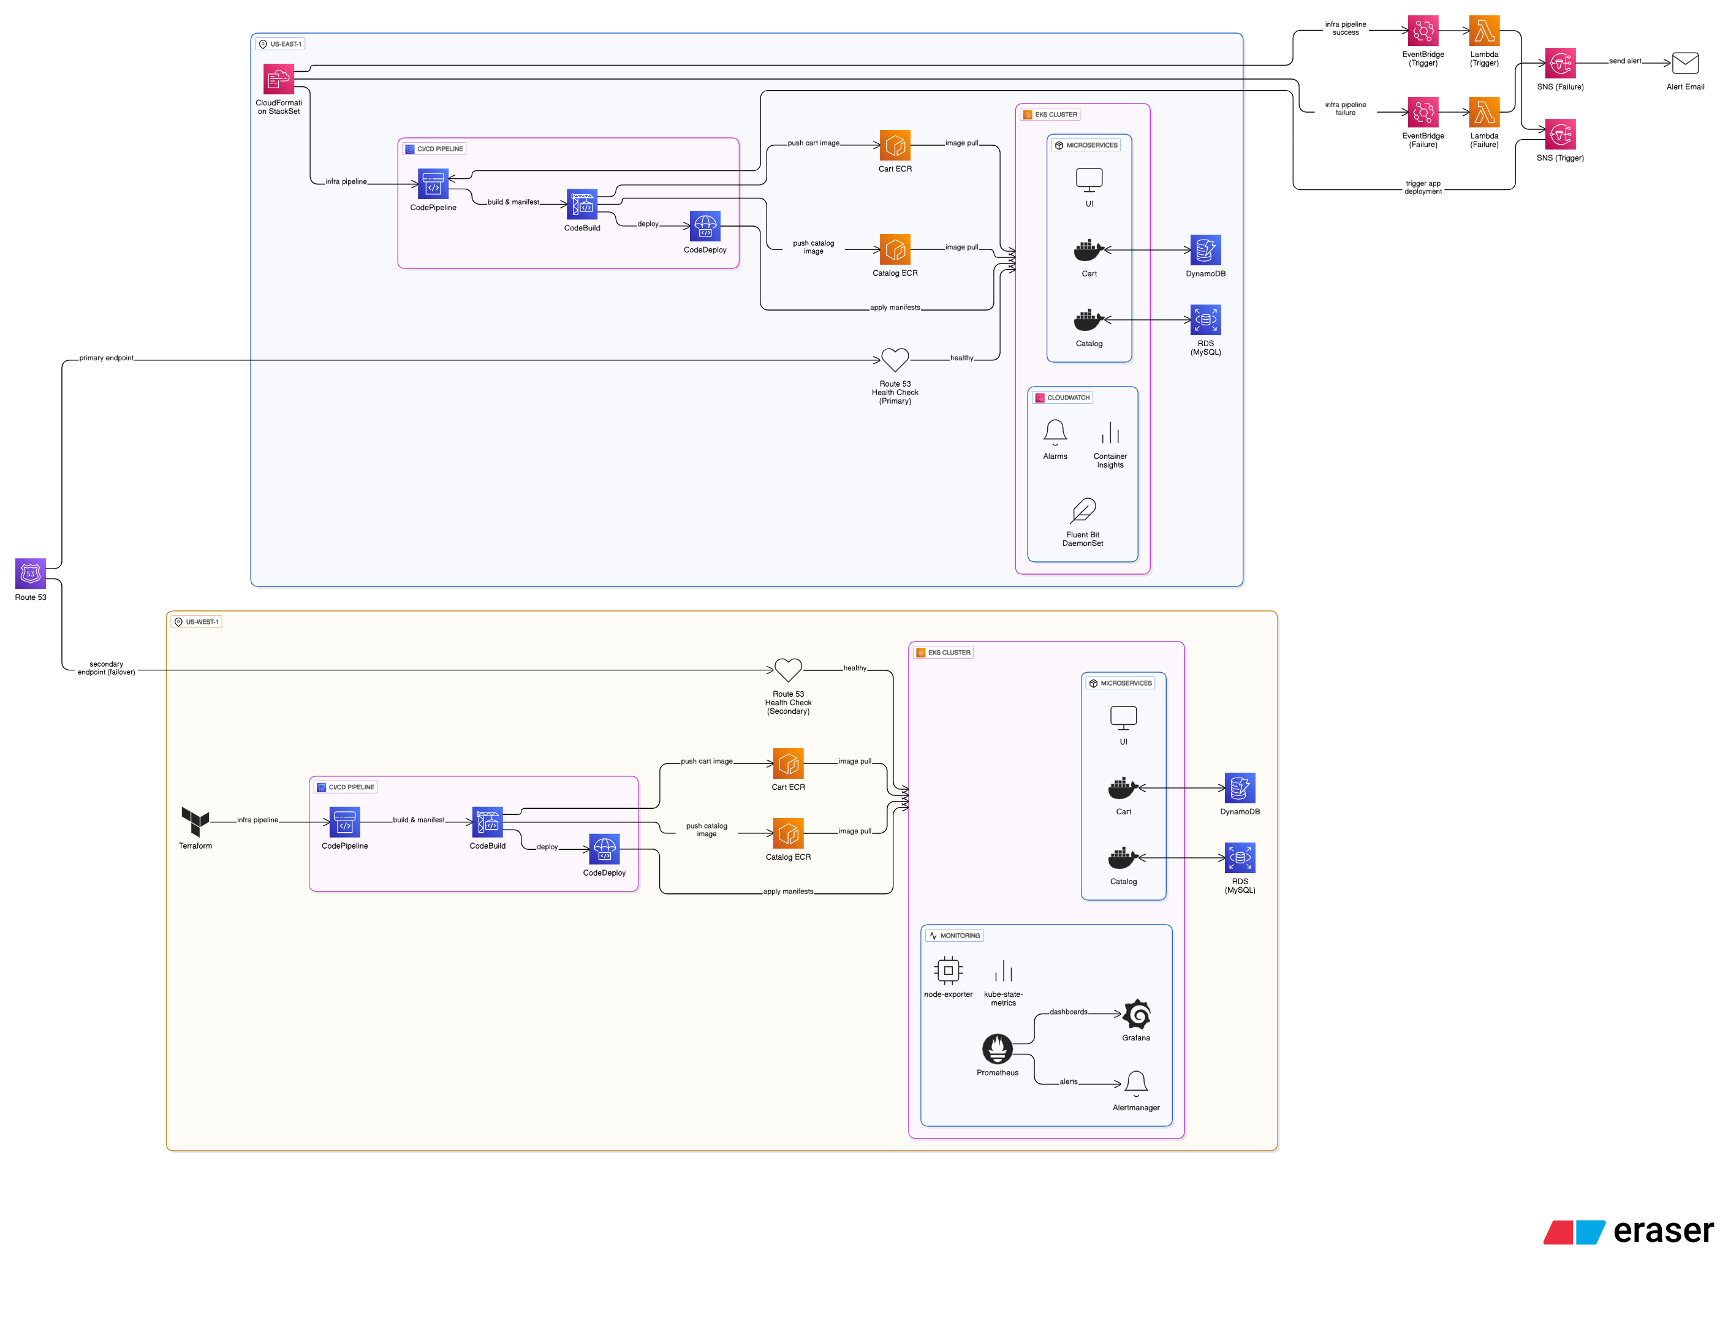
Architecture Diagram

Slide 4
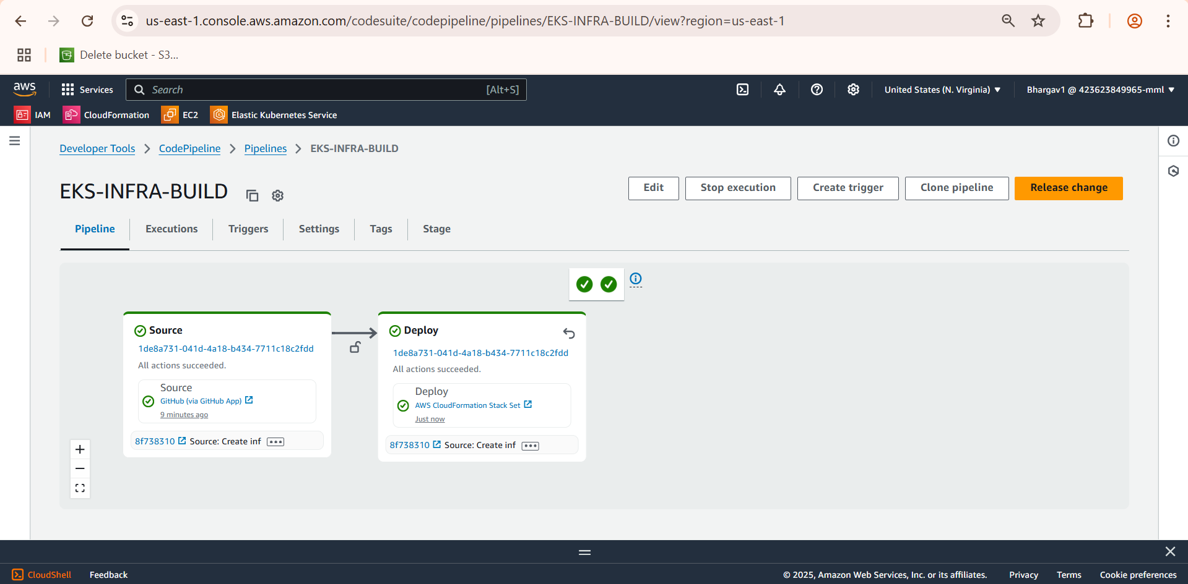
Code Pipeline for Infrastructure

Slide 5
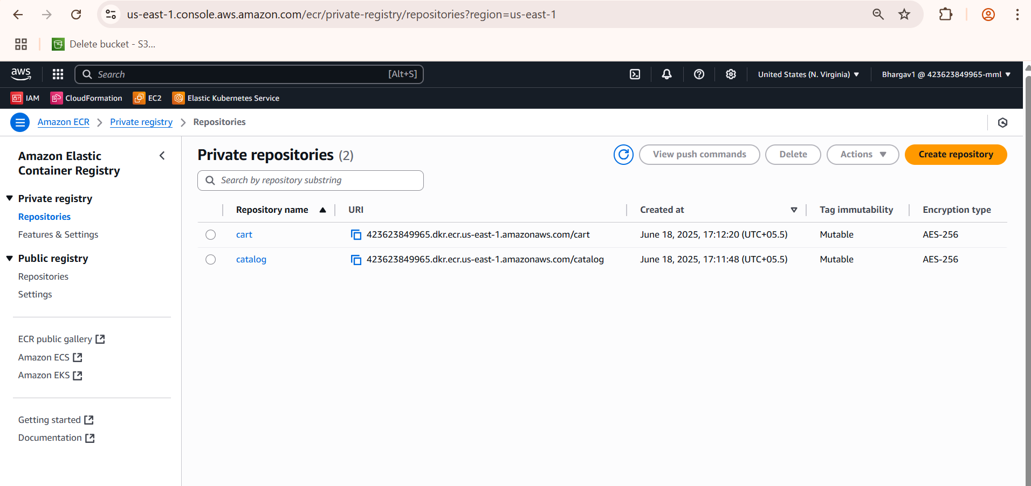
Elastic Container Registry I have created two ECR repositories: one for the Cart service and another for the Catalog service.

Slide 6
CodeBuild
1) Install Phase
Sets up AWS SDK config loading.
2) Pre-Build Phase
Logs in to Amazon ECR using your AWS credentials
Sets environment variables:
Account_Id, Region, DB_Host
3) Build Phase
Navigates into /src/cart , /src/catalog directories
Builds Docker images for both services.
Tags them with the proper ECR image URLs.
4) Post-Build Phase
Docker push for both cart and catalog images
Outputs the processed manifests to the K8s folder
5) Artifacts
Makes the generated deployment YAMLs(cart.yaml, catalog.yaml, ui.yaml) available as build artifacts for later deployment (e.g., by CodeDeploy )

Slide 7
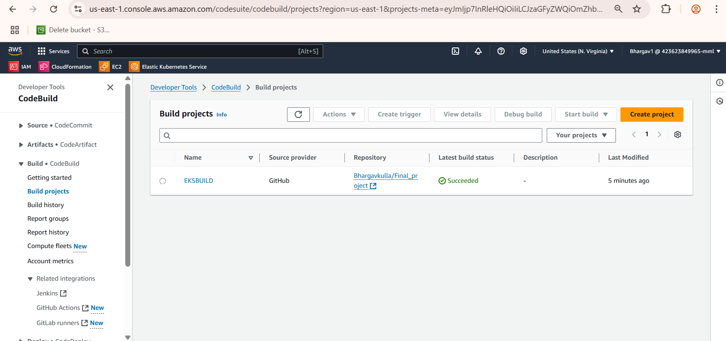
CodeBuild

Slide 8
CodePipeline
After building and pushing the Docker images for the cart and catalog microservices using AWS CodeBuild, the next step is deploying the application to an Amazon EKS (Elastic Kubernetes Service) cluster.
Kubernetes Deployment using cart.yaml, catalog.yaml, and ui.yaml
1)Amazon EKS Setup
I provisioned an Amazon EKS cluster using CloudFormation (us-east-1 region)
2) Manifest Files Used for Deployment
cart.yaml – Deploys the Cart microservice (Deployment + Service).
catalog.yaml – Deploys the Catalog microservice and configures the database connection (RDS endpoint is injected dynamically).
ui.yaml – Deploys the UI service that interacts with both microservices.
3) Deployment Execution
kubectl apply -f k8s/cart.yaml
kubectl apply -f k8s/catalog.yaml
kubectl apply -f k8s/ui.yaml

Slide 9
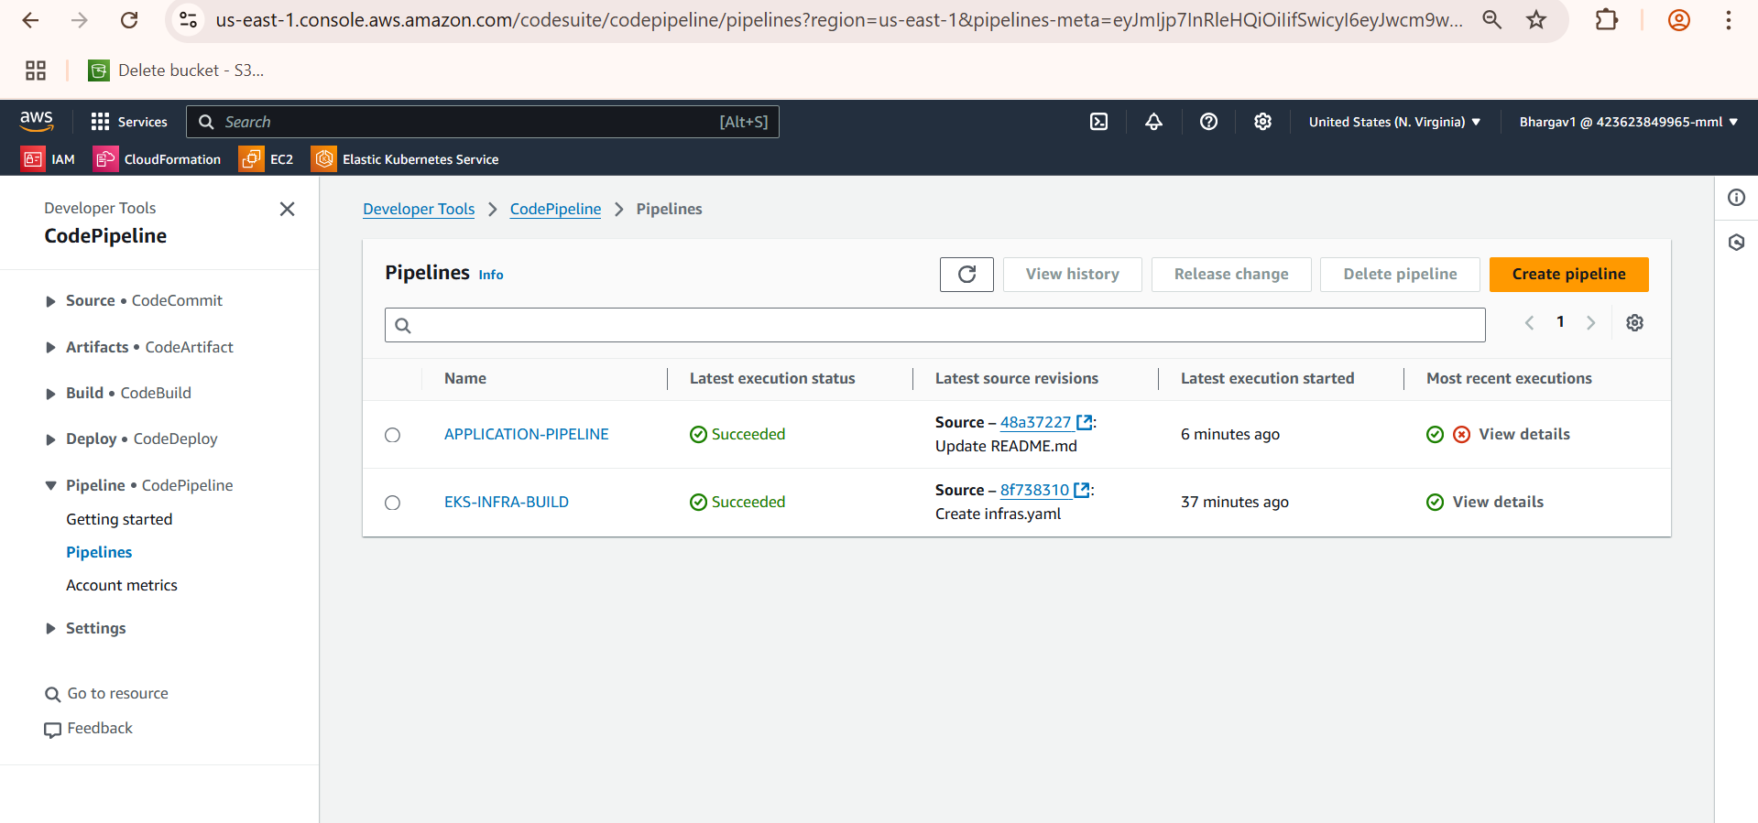
CodePipeline
4) Load Balancer Exposure
The UI service is exposed via a Kubernetes LoadBalancer type service, making it accessible from the internet.
The external URL (from kubectl get svc) is used to access the frontend.

Slide 10
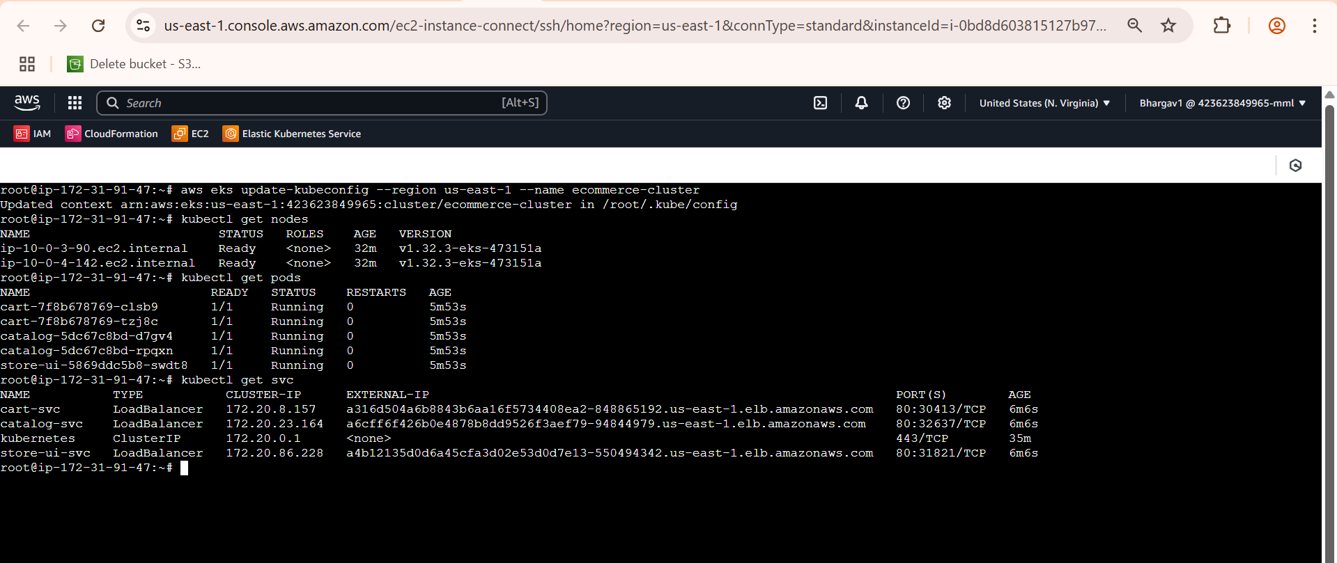

Slide 11
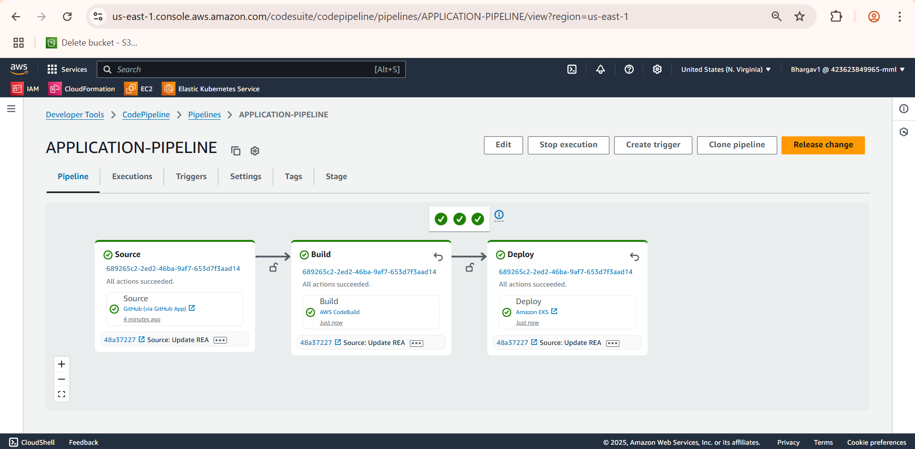

Slide 12
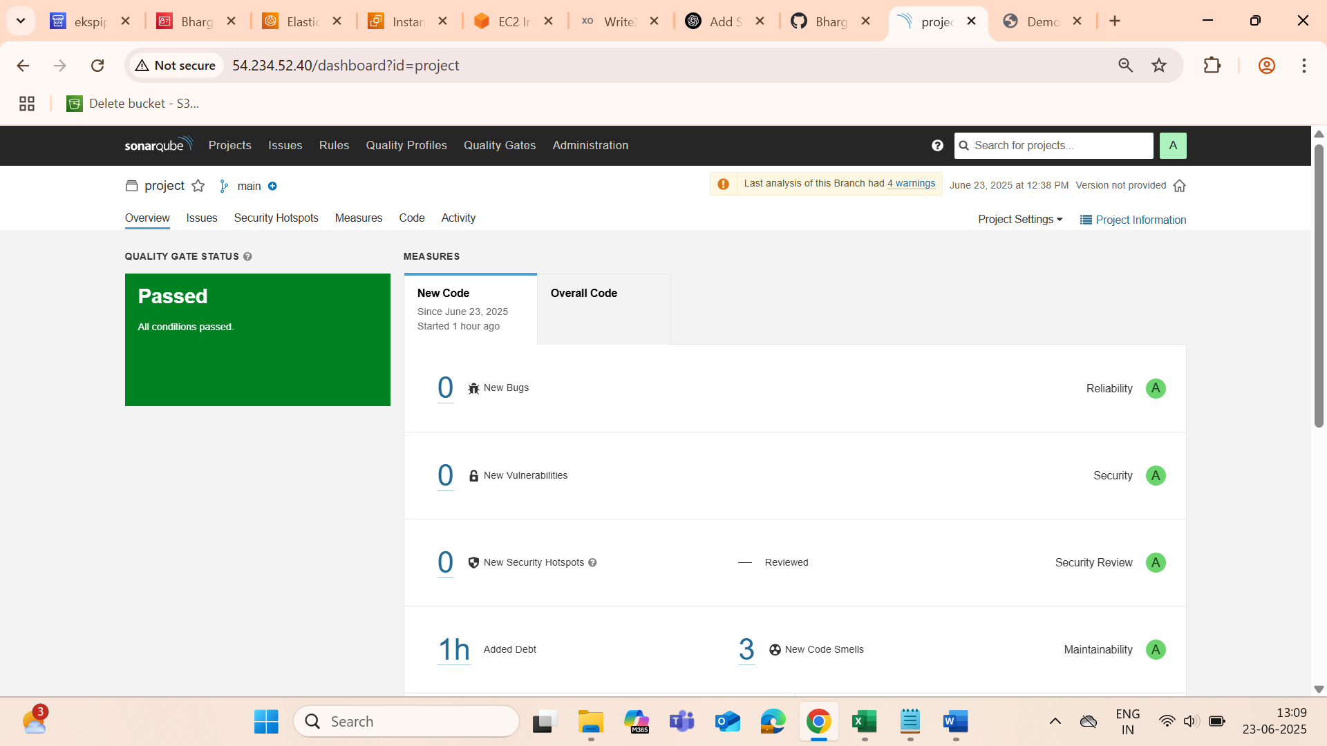
SonarQube
We use SonarQube here to automatically review and measure code quality and security
Code quality is good
There are no bugs, security issues, or duplication
The Quality Gate has passed

Slide 13
Pipeline Trigger Using Lambda, SNS and EventBridge
1)First create a topic 2)Then Confirm subscription
3)After that create a Lambda Function Then add permissions to Lamda
codepipeline:StartPipelineExecution
sns:Publish
4)Now go to EventBridge
create rule
Add codepipeline
Add Specific State: SUCCEEDED
Add Target as Lamda
5)Now validate it, if one pipeline runs successfully then it should trigger to another Pipeline

Slide 14
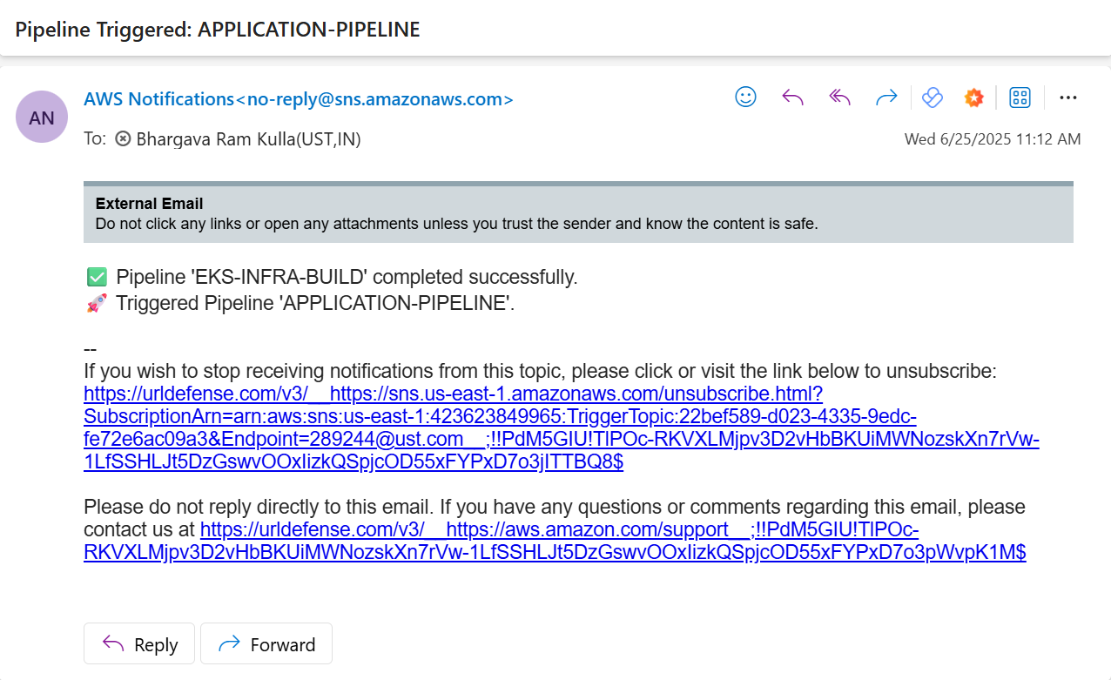

Slide 15
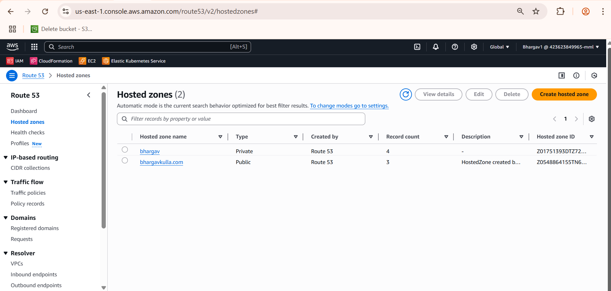
Route53
Bought a domain bhargavkulla.com
Set up a Route 53 health check to monitor the health of the primary endpoint
Configured DNS Record with Failover Routing
Then accessed the website with the domain name bhargavkulla.com

Slide 16
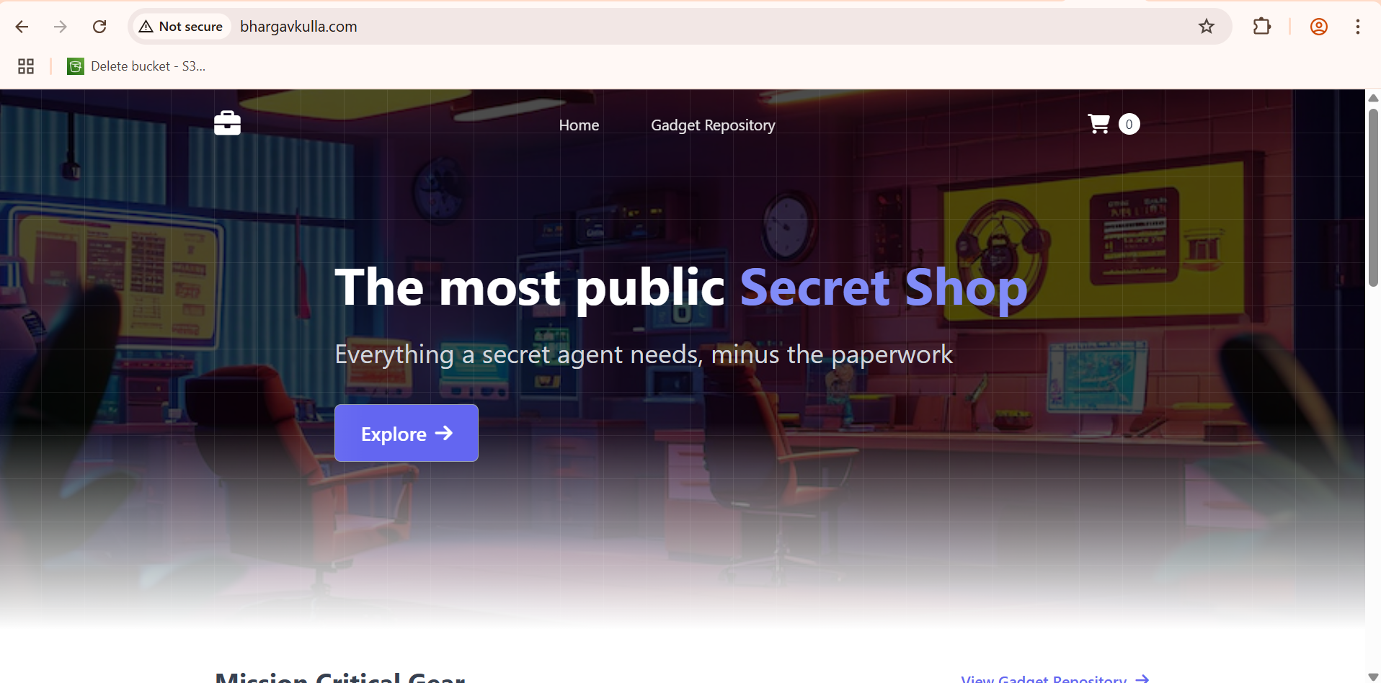

Slide 17
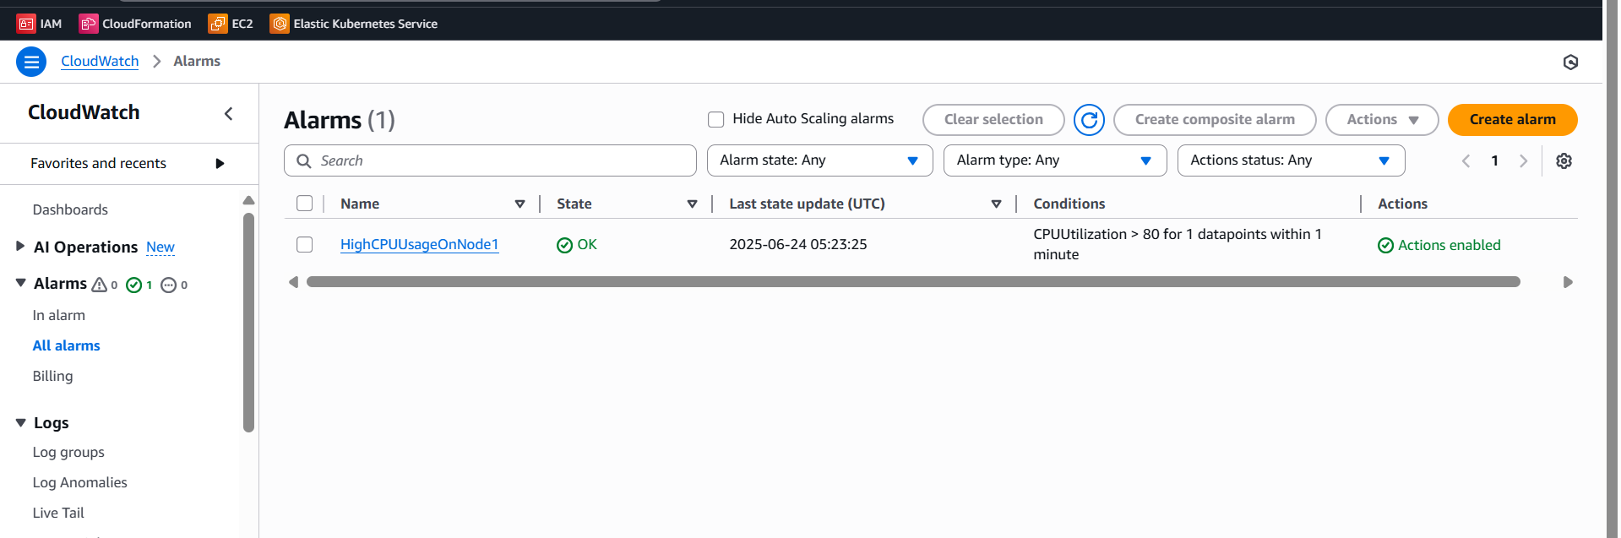
CloudWatch
Monitoring and alerting for EKS was implemented using CloudWatch Container Insights, and SNS email alerts. CloudWatch alarms were configured to notify on high CPU usage with email integration.

Slide 18
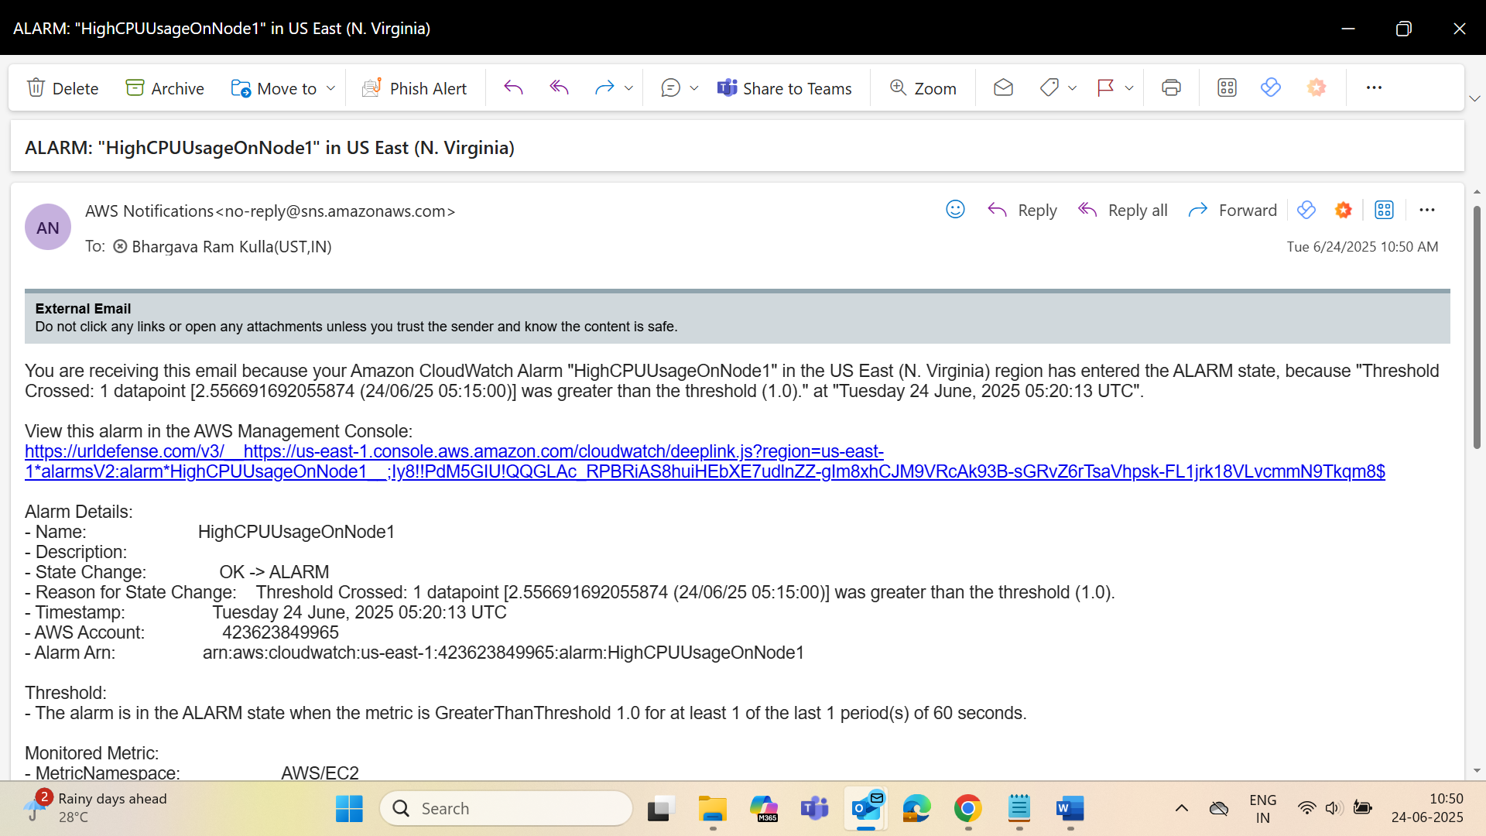
Cloud Watch

Slide 19
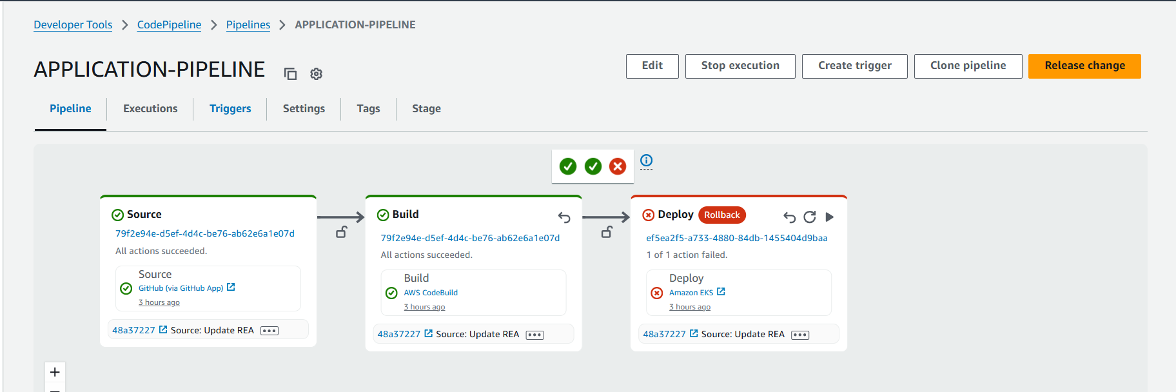
If Pipeline Fails?

Slide 20
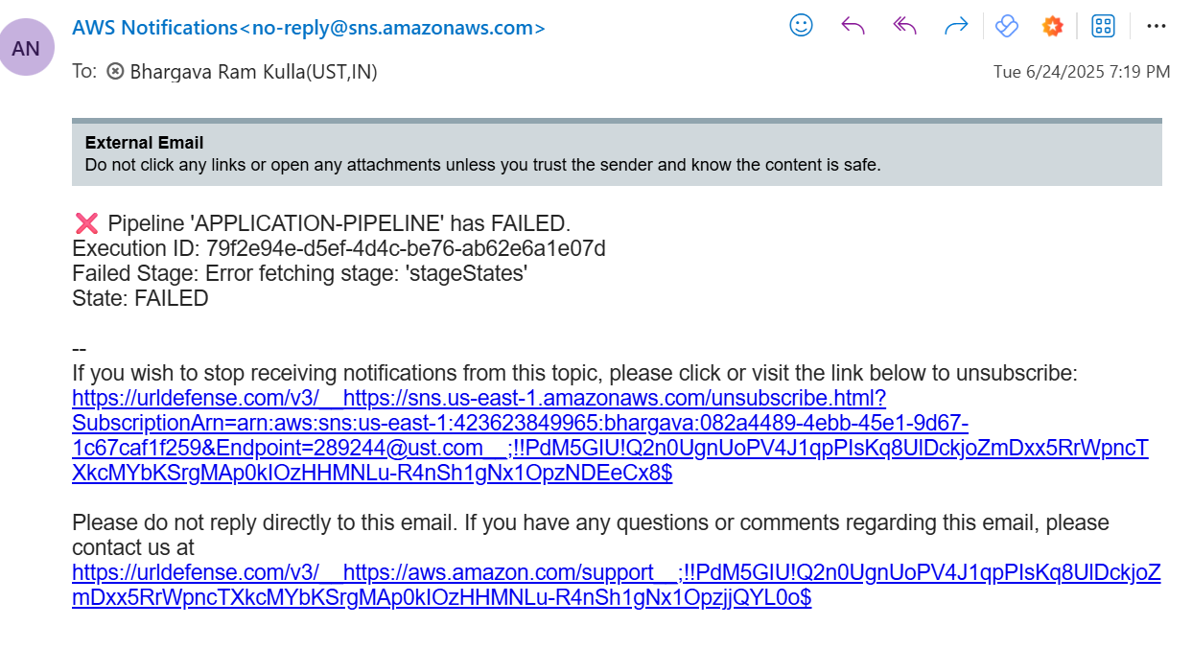
1)We will get mail that Pipeline Failed 2)We will do this using Event Bridge 3)For that First we should create Topic then add subscription 4)Then Create Lamba 5)Then Go to Event Bride and select CodePipeline(Failure)

Slide 21
Region 2 us-west-1
Infrastructure Setup using Terraform
Commands
Terraform init Terraform Plan Terraform apply

Slide 22
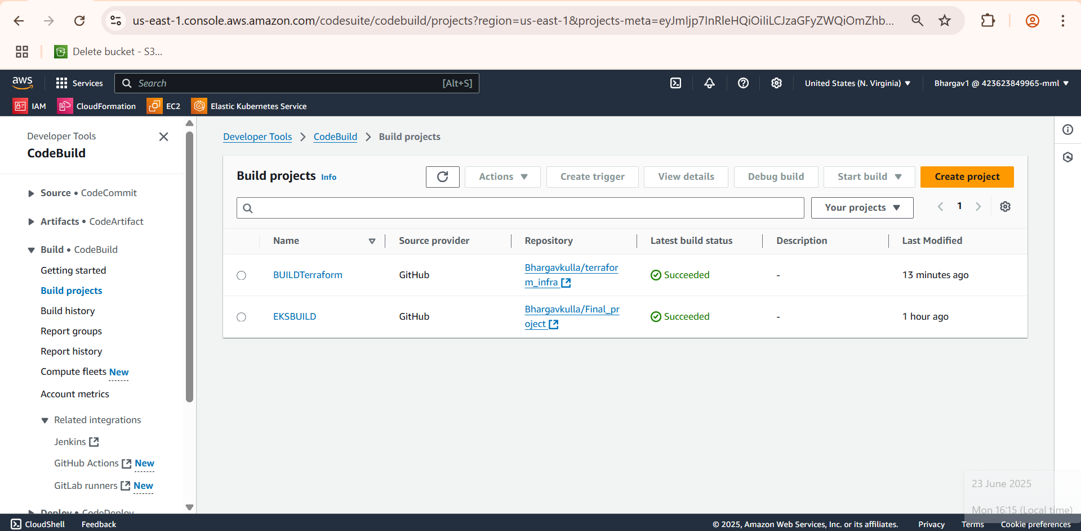
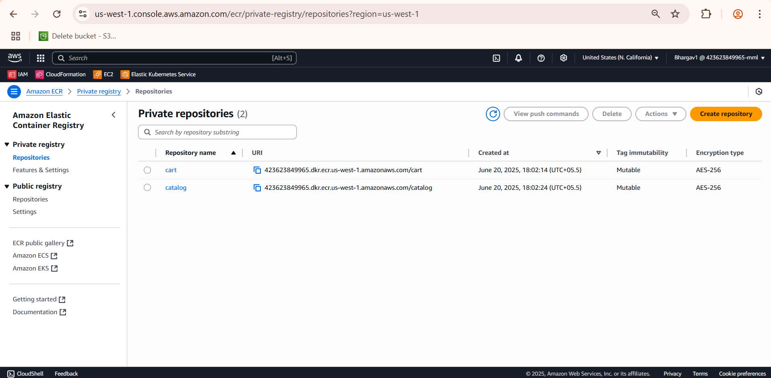
ESEg
ECR Repositories

Slide 23
CodeBuild
1) Install Phase
Ensures the AWS SDK uses the full AWS configuration (region, credentials, etc.)
2) Pre-Build Phase
Logs in to Amazon ECR using your AWS credentials
Sets environment variables:
Account_Id, Region, DB_Host
3) Build Phase
Navigates into /src/cart , /src/catalog directories
Builds Docker images for both services.
Tags them with the proper ECR image URLs.
4) Post-Build Phase
Docker push for both cart and catalog images
Outputs the processed manifests to the K8s folder
5) Artifacts
Makes the generated deployment YAMLs(cart.yaml, catalog.yaml, ui.yaml) available as build artifacts for later deployment (e.g., by CodeDeploy)

Slide 24
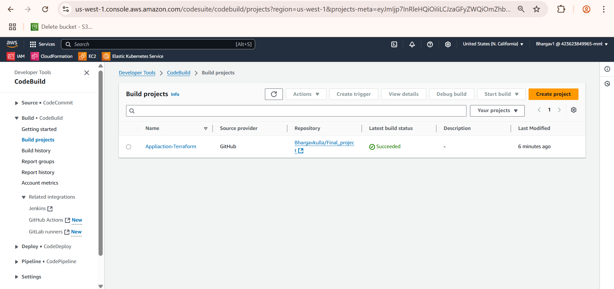

Slide 25
Code Pipeline
After building and pushing the Docker images for the cart and catalog microservices using AWS CodeBuild, the next step is deploying the application to an Amazon EKS (Elastic Kubernetes Service) cluster.
Kubernetes Deployment using cart.yaml, catalog.yaml, and ui.yaml
1)Amazon EKS Setup
I provisioned an Amazon EKS cluster using Terraform (us-west-1 region)
2) Manifest Files Used for Deployment
cart.yaml – Deploys the Cart microservice (Deployment + Service).
catalog.yaml – Deploys the Catalog microservice and configures the database connection (RDS endpoint is injected dynamically).
ui.yaml – Deploys the UI service that interacts with both microservices.
3) Deployment Execution
kubectl apply -f k8s-out/cart.yaml
kubectl apply -f k8s-out/catalog.yaml
kubectl apply -f k8s-out/ui.yaml

Slide 26
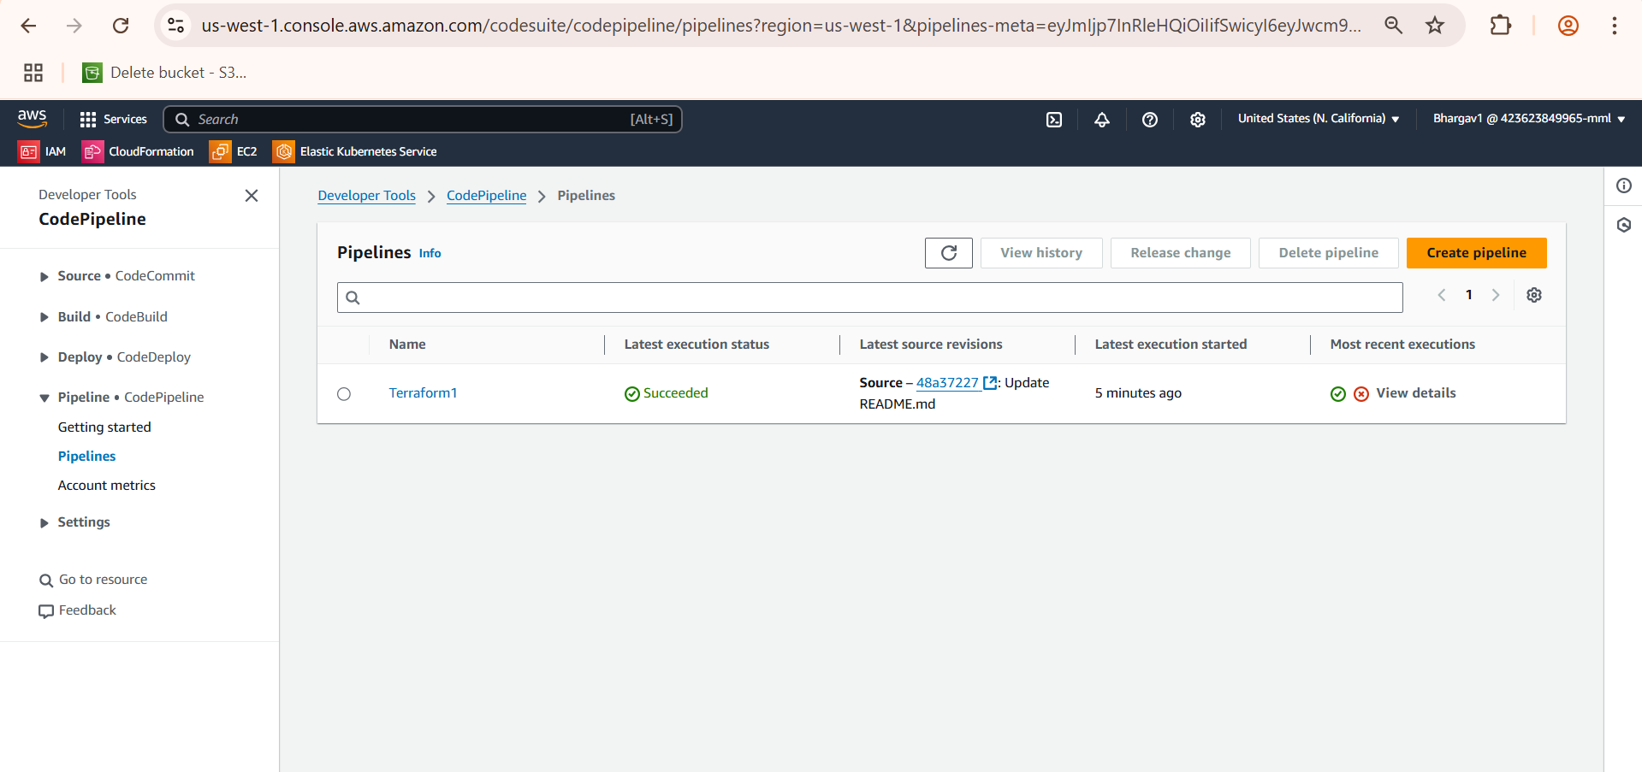
CodePipeline
4) Load Balancer Exposure
The UI service is exposed via a Kubernetes LoadBalancer type service, making it accessible from the internet.
The external URL (from kubectl get svc) is used to access the frontend.

Slide 27
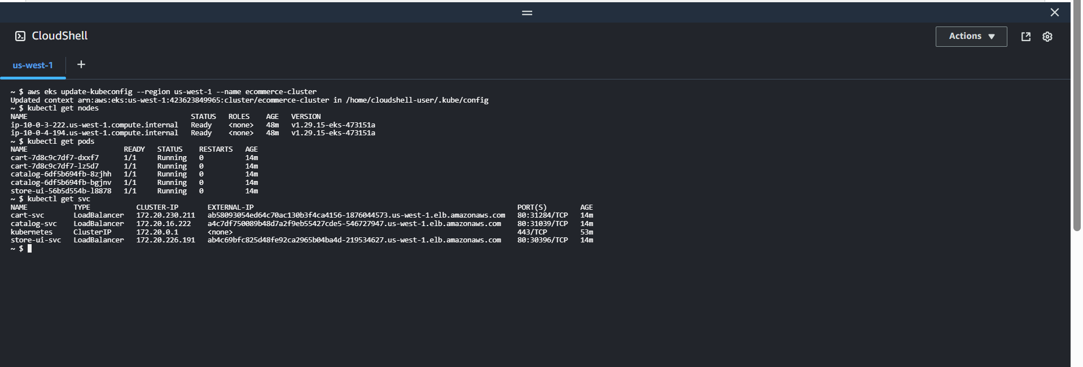
CodePipeline

Slide 28
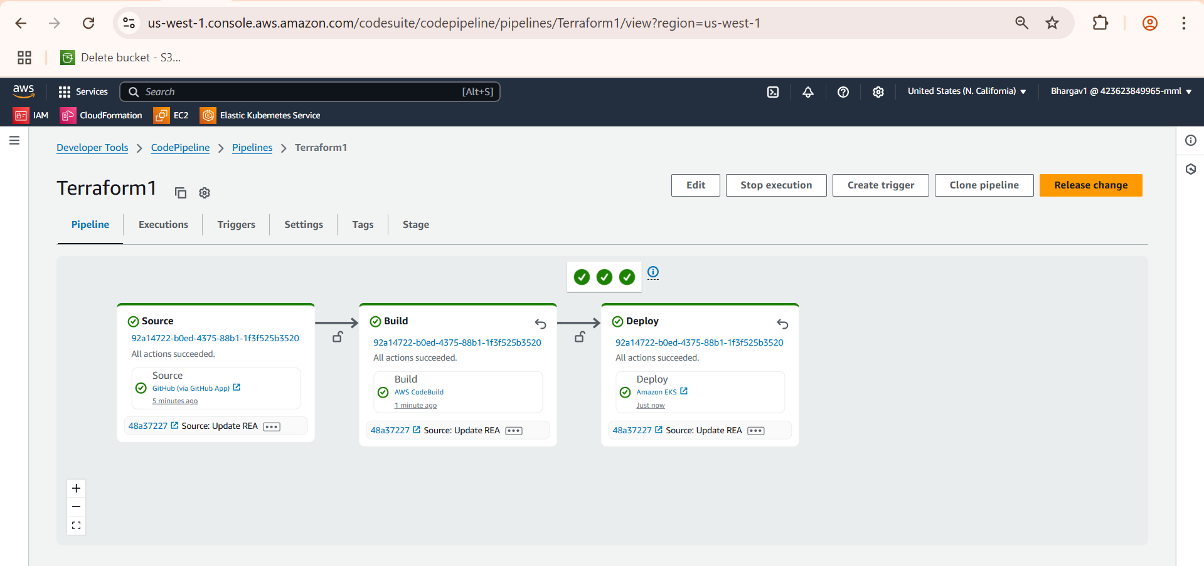

Slide 29
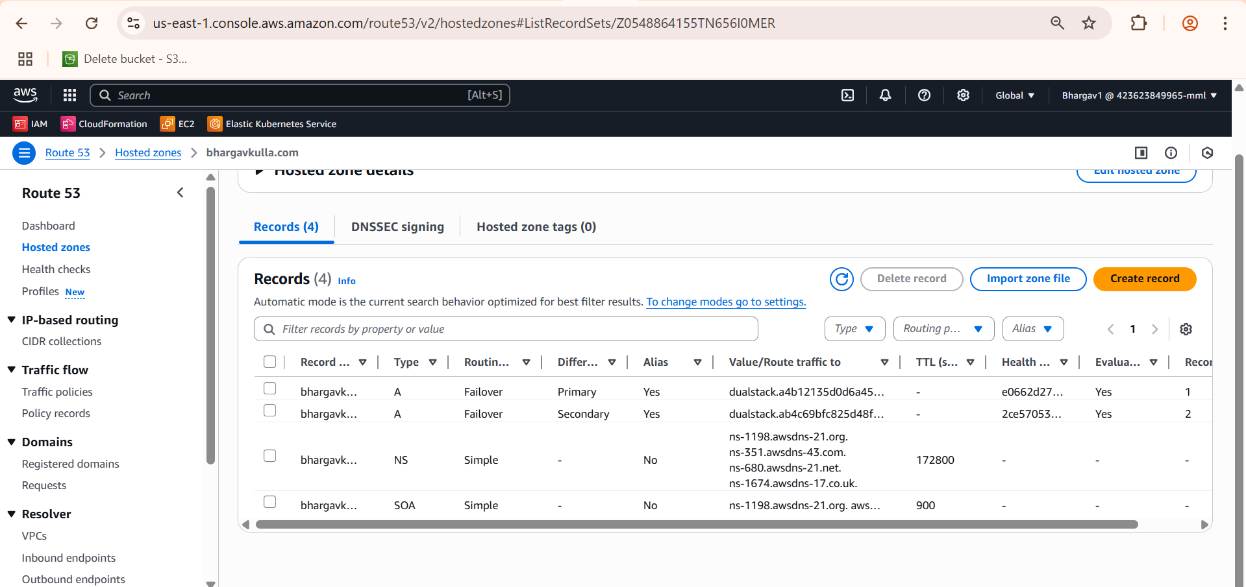
Route53
Bought a domain bhargavkulla.com
Set up a Route 53 health check to monitor the health of the secondary endpoint
Created a second record
Configured DNS Record with Failover Routing
Then accessed the website with the domain name bhargavkulla.com
When the primary fails (health check fails) → Route 53 automatically fails over to the secondary.

Slide 30
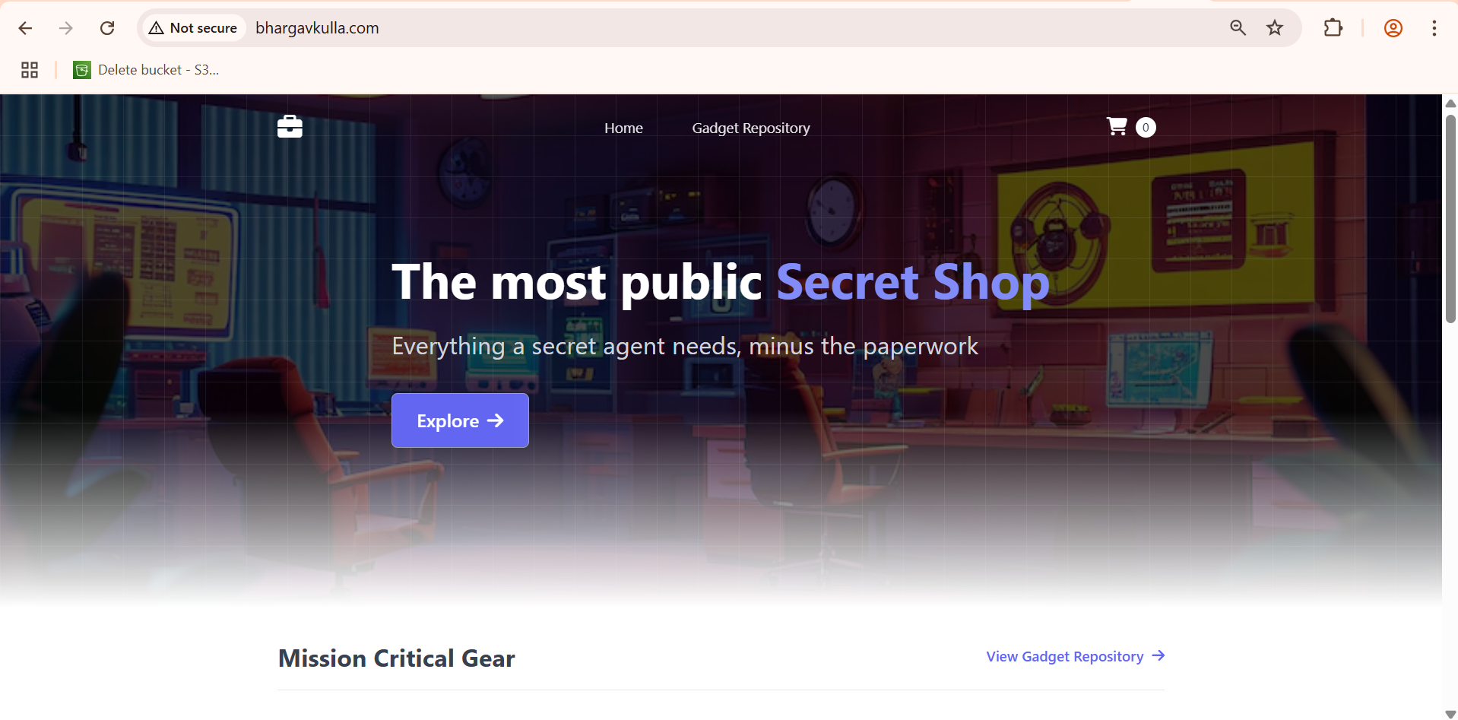

Slide 31
Prometheus and Grafana
Deployment: I have deployed the Prometheus and Grafana components into a dedicated monitoring namespace within my EKS cluster. This includes:
prometheus-kube-prometheus-stack-prometheus (The Prometheus server itself)
grafana (The Grafana server)
kube-state-metrics (Exposes metrics about the state of Kubernetes objects like deployments, pods, nodes)
prometheus-node-exporter (Exposes host-level metrics from your EC2 instances/EKS nodes)
alertmanager (Handles alerts generated by Prometheus rules)
Dashboarding: I have set up various Grafana dashboards to visualize different aspects of my cluster and application performance

Slide 32
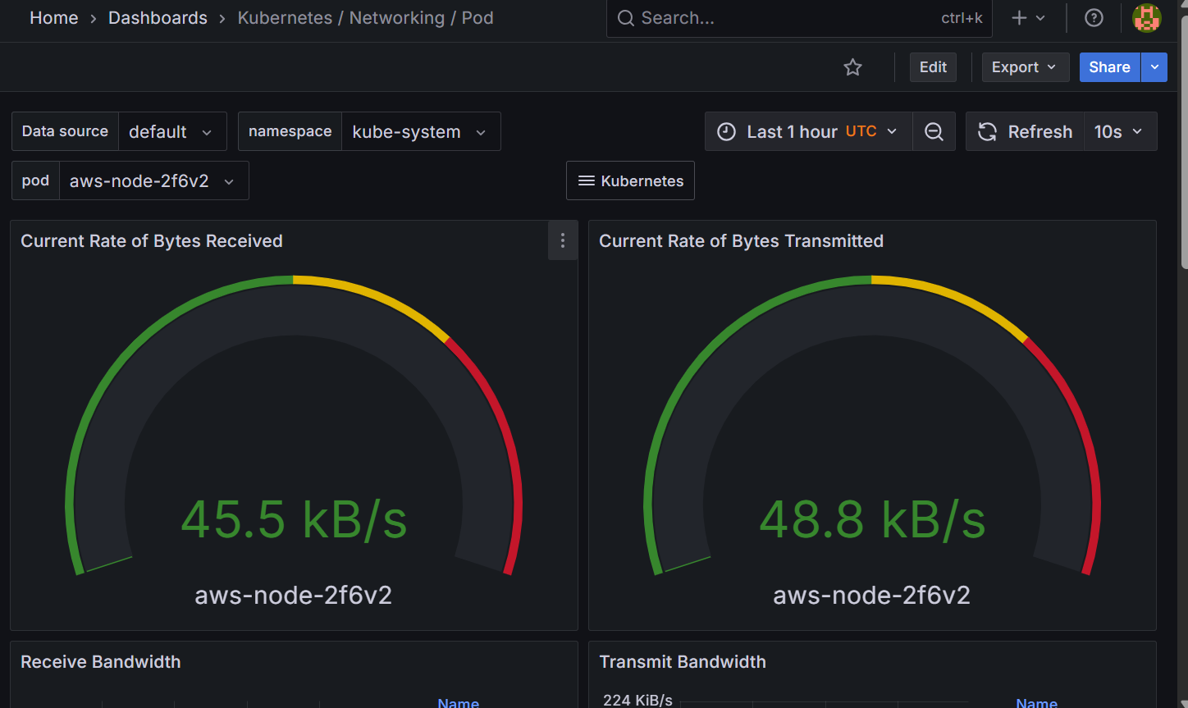

Slide 33
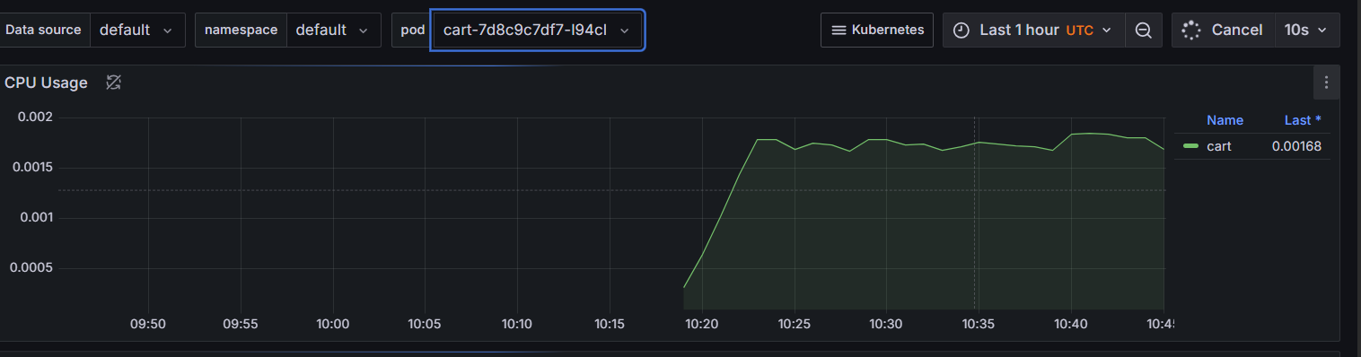
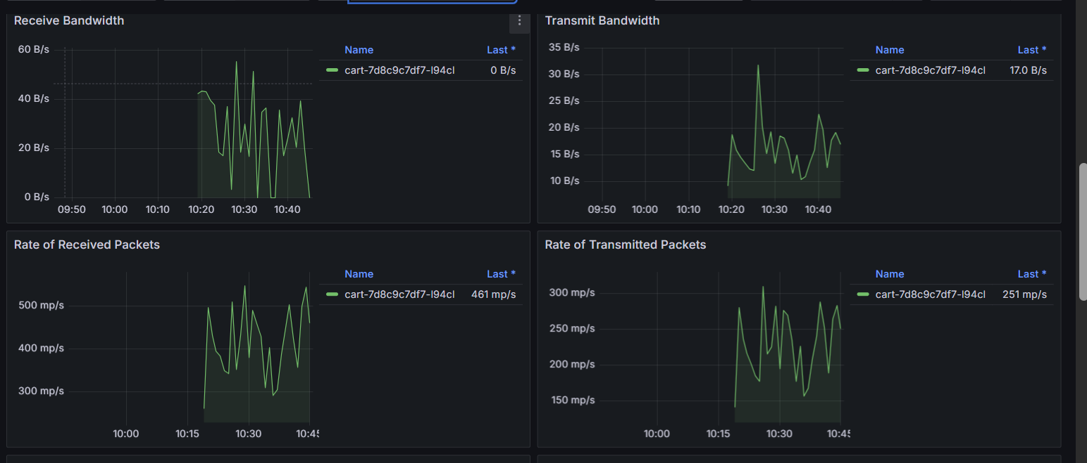

Slide 34
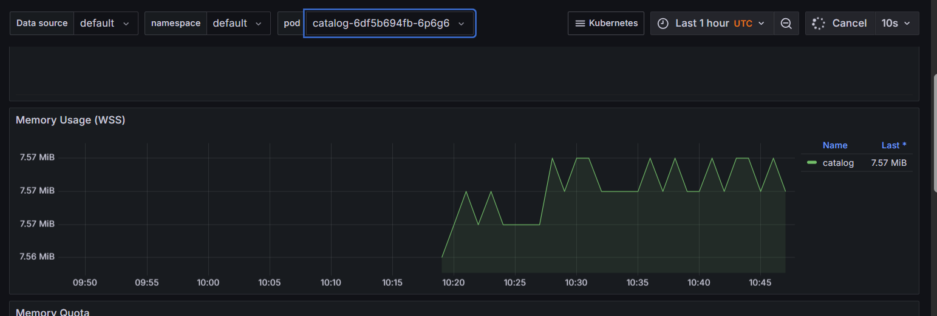
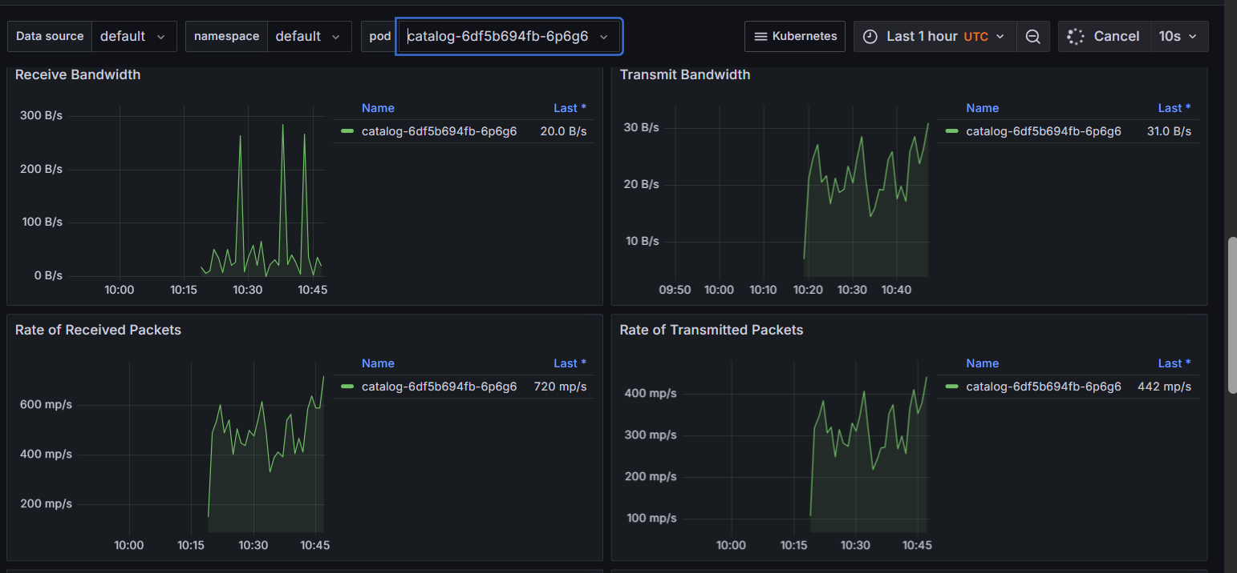

Slide 35
GitHub URL
https://github.com/Bhargavkulla/aws_project_info.git

Slide 36

Thank You

